Slide 1
Orthopedic Surgery Shouldn't Cost an Arm and a Leg!!

Slide 2
Topics
Market Dynamics
How buying decisions are made and the implications of those decisions
Supply Chain/Distributor Dynamics
Markups and Net Cost Identification
Opportunities for Cost Savings

Slide 3
Key Industry Challenges— Market Dynamics
US demand for implantable medical devices is forecast to increase 7.7 percent annually to $52 billion in 2015. Orthopedic implants will remain the largest segment and be one of the fastest growing.
Other implants expected to experience exponential growth include neurostimulators and drug implants* (widely utilized in Workers Compensation procedures)
*Freedonia Group, Implantable Medical Devices to 2015
Notes:
NS Notes
Rev Code 278
HCPCS Code L8699 are dump/misc codes for almost all these implants

Slide 5
Vendor Selection
Most implants are Physician Preference Items
Fellowship Support
Training
Impediments to change;
Relationships with sales reps,
Time required to learn new systems,
Little difference in outcomes for average patient population
New Surgeon Acquisition Strategies
New Product
Hire Key Sales Rep

Slide 6
The Implications of Surgeon Choice
Hospital/ASC responsibility to negotiate pricing, purchase, manage inventory, bill and collect for surgical implants
Surgeons (vendor “customer”) are detached from the financial implications of their choices (with exceptions being some physician owned facilities)
This detachment can lead to vendor rep influence in the OR

Slide 7
Materials Management
Vendor Direct
Distributor Model
Inventory Management
Impact of GPO’s
Notes:
Vendor Direct
Distributor Model- Stocking vs Non Stocking
Inventory Management- Large institutions will buy in bulk, Most implants have stickers with Lot and Serial Numbers (part of medical record), Materials management departments responsible for ensuring that the right implants are available for a surgeon prior to surgery (lean on vendors heavily for support)
Impact of GPO’s

Slide 8
What is Cost?
List Price- Highest Possible Price Point
True Net Cost
Discounting and Rebate Structures
Markups
Reimbursement Methodologies

Slide 9
True Cost and Reimbursement

Slide 10
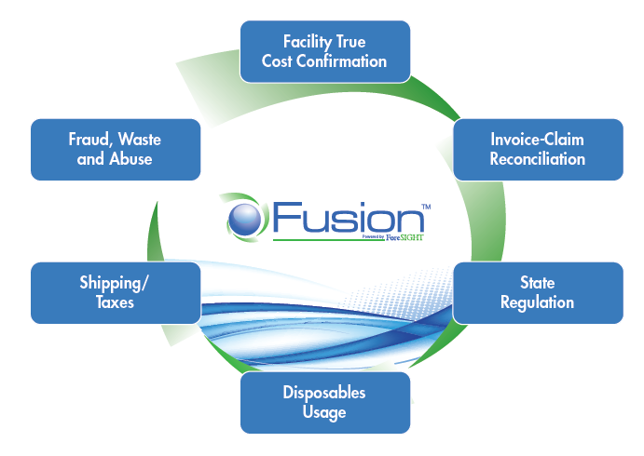
Cost Savings Opportunities

Slide 11
Questions

